Slide 1
CCIC 2018 Member Forum Using Data to Reduce Costs and Improve Health
June 12, 2018

Slide 2
AGENDA
Introductions
Goals and Objectives of Session
Background on edHEALTH and MMA
Data Resources
Data Analytics and Informatics in Action
Questions & Answers

Slide 3
Goals and Objectives of Session
Demonstrate how edHEALTH uses data to address plan design and health plan costs
Discuss National, edHEALTH and local (school) level trends
Illustrate the collaboration between edHEALTH and MMA or with participating school’s broker and/or consultant
Identify future opportunities for collaboration

Slide 4
Who Are We?
Bringing a cost-saving and innovative solution that offers members collaboration, transparency, and a seat at the table, edHEALTH is the powerful answer to impact the trend in rising healthcare costs.

Slide 5
Overview
Since July 1, 2013….
14 educational institution members/owners
11,000+ covered employees
Premiums paid exceed $150 million annually
Average rate increases in 2018: 2.1%
Average annual increase since inception: 3.1%
$5.2 million allocated to members/owners to date
edHEALTH paid $1.2M dividend to founding members
$4M invested

Slide 6
Who is Marsh & McLennan Agency?
Marsh & McLennan Agency (MMA) specializes in serving the risk management and employee benefit needs of colleges and universities throughout the United States
Our parent company is Marsh which is one of the largest insurance brokerage firms in the world
In New England, MMA has an Employee Benefits practice that focuses on higher education
Our team has been involved with edHEALTH since its inception
MMA currently consults with 5 of the 14 participating edHEALTH schools
We provide edHEALTH with benchmarking data using Mercer’s 2017 Employer-Sponsored Health Plan Survey
We work collaboratively with edHEALTH, yet our solutions are design around the specific needs of the institution

Slide 7
Data, Data, and More Data
GOAL: guide schools individually and collectively in choosing wellness initiatives and plan designs to impact cost and quality of healthcare
Benchmark analysis is updated annually
Analysis of cost and utilization by types of service to include year over year results
Benchmarking of claims by diagnosis

Slide 8
Data, Data, and More Data
Demographics
Medical and Rx
Services
Cost Analysis
Member Age
Contract Size
Male/Female %
Total $PMPM Costs
Cost Sharing
$PMPM
Utilization/member
Cost/utilization
Inpatient
Outpatient
Physician Services
Ancillary Services
$PMPM:
Top Diseases
Clinical Condition
Top Major Diagnostic Categories
Claims Distribution
High Cost Claimants

Slide 9
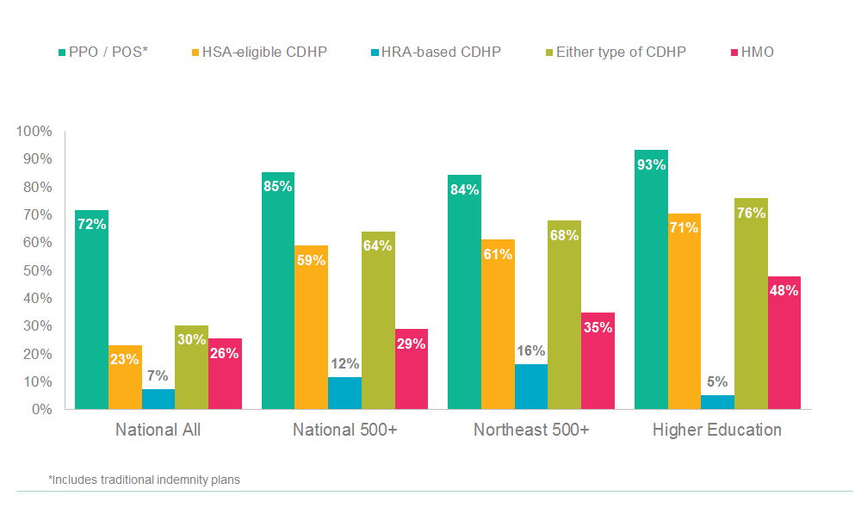
Percent of Employers Offering Each Type of Medical Plan

Slide 10
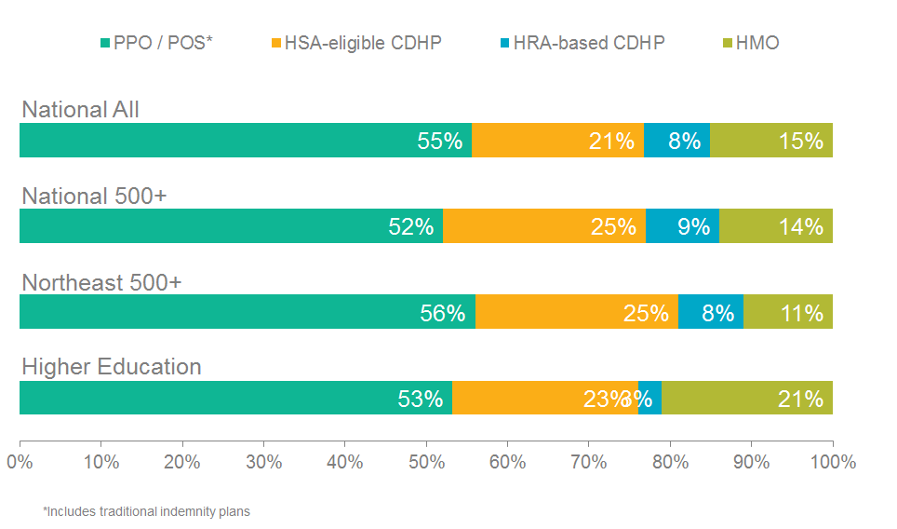
Medical Plan Enrollment Trends
National
edHEALTH
School
The University engaged in aggressive campaign to promote HDHP with HSA.
“Town Hall” meetings were held, 10 educational sessions
University promised to fund HSA ($500 for single, $1,000 for family)
Medical provider showcased transparency tools
25% of 800 eligible subscribers enrolled in HDHP
Also changed to self funded medical plan
Cost increase was substantially lower than previous years and well below industry trends

Slide 11
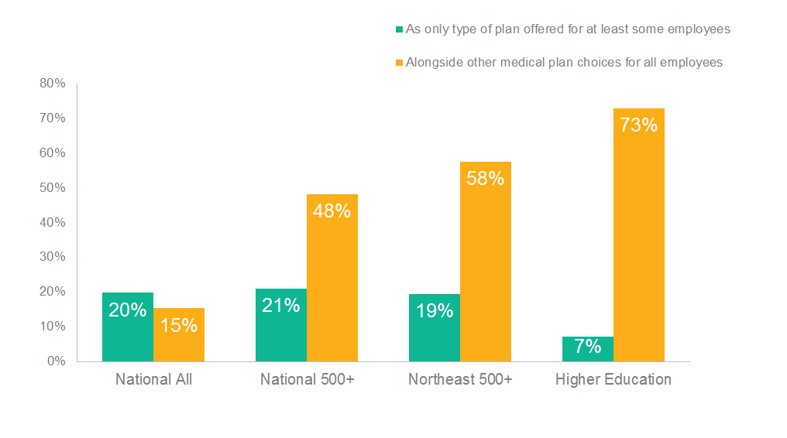
Expect to offer an account-based CDHP in next three years

Slide 12
Medical Services Trends
National
2018
Medical: 9.8%
Rx: 11.0%
Total: 10%
edHEALTH
2018
Medical/Rx:
Tufts HMO 6.2%
Tufts PPO 9.3%
HPHC: 7%
Optum: 7%
School
2018
Medical/Rx:
Overall 2.1% increase to working rates

Slide 13
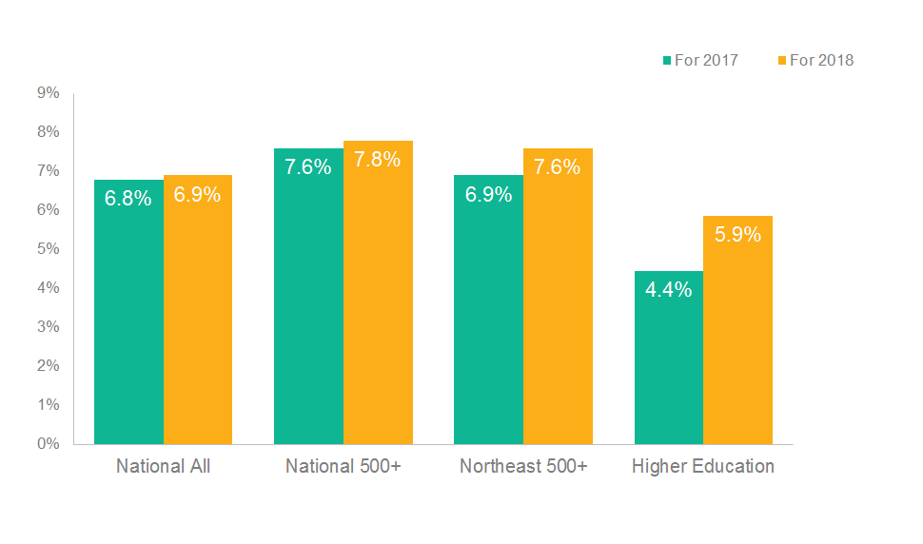
Annual Change in Cost per Employee for Prescription Drug Benefit

Slide 14
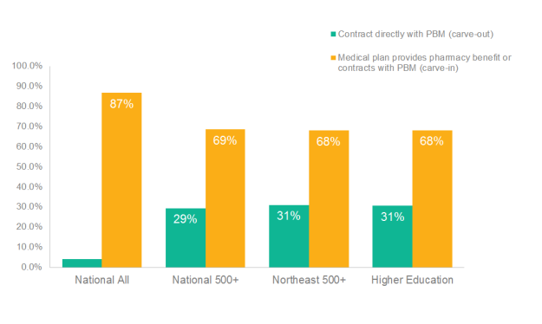
Rx Trends
National
edHEALTH
School
Rx trends have come down
Significant, strategic and important move for edHEALTH
Joined PURPC Coalition – OPTUM Rx on 1/1/17
Savings of $3M first year with minimal disruption
Estimated annual savings (claims and rebates) due to Carve-Out to be 2% of claims
For 2017, the savings is assumed to be 1% or $148,000
For 2018 and beyond, expectation is 2% savings of claim spend, or $310,000 in 2018, $333,000 in 2019, resulting in potential 3-year savings of $791,000
Rebates/claims savings based upon historical Rx utilization/spend

Slide 15
Disease Trends – Ranked Average PMPM Cost
National
Cancer, All
Depression
Diabetes
Hypertension
Osteoarthritis
edHEALTH
Cancer, All
Depression
Osteoarthritis
Cancer, Breast
Diabetes
School
Cancer, All
Cancer, Breast
Chronic Condition
Diabetes
Multiple Sclerosis

Slide 16
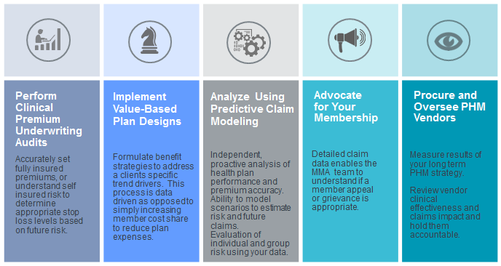
Data Analytics and Informatics in Action Proactively Impacting Plan Performance

Slide 17
Our Members

Slide 18
Please send your feedback to:
1-866-692-7473
1-617-777-4762
info@educatorshealth.org
Joan.Cunnick@MarshMMA.com
www.educatorshealth.org
MMA-NE.com

